Slide 1
SQL Server
Constraints
In all slides, db=database

Slide 2
Constraints
A constraint is a restriction. Placed at either column or table level, a constraint ensures that your data meets certain data integrity rules.

Slide 3
Constraint Categories
Each kind of constraint falls into one of the following categories
  Domain constraints
  Entity constraints
  Referential Integrity constraints

Slide 4
Domain Constraints
Domain constraints deal with one or more columns. This is ensuring a column or set of columns meets particular criteria.
When you insert or update a row, the constraint is applied without respect to any other row in the table—it's the column's data you're interested in.

Slide 5
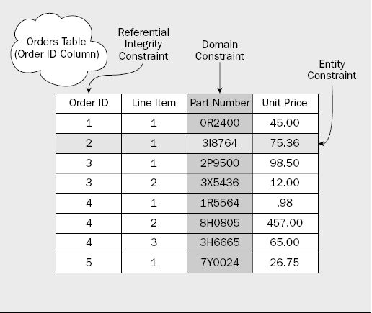
Domain Constraints cont.
If we want to confine the
UnitPrice column only
to values that are greater
than or equal to zero, that
would be a domain
constraint.
While any row that had a
UnitPrice that didn't meet
the constraint would be
rejected, we're actually enforcing integrity to make sure that entire column (no matter how many rows) meets the constraint.
The domain is the column, and our constraint is a domain constraint.

Slide 6
Entity Constraints
Entity constraints are all about individual rows. This form of constraint doesn't really care about a column as a whole; it's interested in a particular row, and would best be exemplified by a constraint that requires every row to have a unique value for a column or combination of problems.
For this row, the same value can't already exist in some other row.

Slide 7
Referential Integrity
Referential integrity constraints are created when a value in one column must match the value in another column—in either the same table or, far more typically, a different table.

Slide 8
Referential Integrity cont.
Let's say that we are taking orders for a product, and that we accept credit cards. In order to be paid by the credit card company, we need to have some form of merchant agreement with that company. We don't want our employees to take credit cards from companies from which we're not going to be paid back. That's where referential integrity comes in—it allows us to build what we would call a domain or lookup table. A domain table is a table whose sole purpose in life is to provide a limited list of acceptable values.

Slide 9
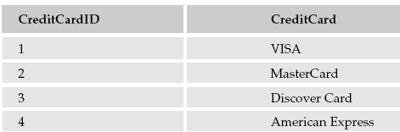
Referential Integrity cont.
We can then build one or more tables that reference the CreditCardID column of our domain table. With referential integrity, any table (such as our Orders table) that is defined as referencing our CreditCard
table will have to have a column that matches up to the CreditCardID column of our CreditCard table. For each row that we insert into the referencing
table, it will have
to have a value
that is in our
domain list (it will have to have a corresponding row in the CreditCard table).

Slide 10
Constraint Naming
You can let SQL Server supply a name for a restraint automatically, but the name is often not specific.
You should create your own names for constraints
Remember to
  Be consistent with your naming
  Make it something everyone can understand
  Keep it as short as you can while meeting the preceding rules

Slide 11
Key Constraints
There are four different types of common keys that you may hear about
  primary keys
  foreign keys
  alternate keys
  inversion keys
Inversion keys, rather than enforcing data integrity, are merely an alternative way of sorting the data.

Slide 12
PRIMARY KEY Constraints
Relational databases are constructed on the idea of being able to “relate” data. It is critical in relational databases for most tables to have a unique identifier for each row.
A unique identifier allows you to accurately reference a record from another table in the database—so forming a relation between those two tables.

Slide 13
Primary Key cont.
Primary keys are the unique identifiers for each row. They must contain unique values and cannot be NULL.
Because of their importance in relational databases, primary keys are the most fundamental of all keys and constraints.
A table can have a max of 1 primary key.
  The primary key can be composed of one or more columns

Slide 14

Primary Key at Table Creation
CREATE TABLE Customers
(
CustomerNo int IDENTITY NOT NULL
PRIMARY KEY,
CustomerName varchar(30) NOT NULL,
Address1 varchar(30) NOT NULL,
Address2 varchar(30) NOT NULL,
City varchar(20) NOT NULL,
State char(2) NOT NULL,
Zip varchar(10) NOT NULL,
Contact varchar(25) NOT NULL,
Phone char(15) NOT NULL,
FedIDNo varchar(9) NOT NULL,
DateInSystem smalldatetime NOT NULL
)

Slide 15
Add Primary Key with ALTER TABLE
Our ALTER command tells SQL Server:
That we are adding
something to the table
(we could also be
dropping something
from the table if we
so chose)
What it is that we're adding (a constraint)
What we want to name the constraint (to allow us to address the constraint directly later)
The type of constraint (PRIMARY KEY)
The column(s) that the constraint applies to
USE Accounting
ALTER TABLE Employees
ADD CONSTRAINT PK_EmployeeID
PRIMARY KEY (EmployeeID)

Slide 16
FOREIGN KEY Constraints
Foreign keys are both a method of ensuring data integrity and a manifestation of the relationships between tables.
When you add a foreign key to a table, you are creating a dependency between the table for which you define the foreign key (the referencing table) and the table your foreign key references (the referenced table).

Slide 17
Creating table with foreign key
Note that the actual column
being referenced
must have either a
PRIMARY KEY or
a UNIQUE constraint
defined on it
USE Accounting
CREATE TABLE Orders
(
OrderID int IDENTITY NOT NULL
PRIMARY KEY,
CustomerNo int NOT NULL
FOREIGN KEY REFERENCES Customers(CustomerNo),
OrderDate smalldatetime NOT NULL,
EmployeeID int NOT NULL
)

Slide 18
Seeing the constraint
Run the following command to see information about the table with the constraint:
EXEC sp_helpconstraint <table name>

Slide 19
Adding a foreign key
ALTER TABLE Orders
ADD CONSTRAINT FK_EmployeeCreatesOrder
FOREIGN KEY (EmployeeID) REFERENCES Employees(EmployeeID)

Slide 20
Making a Table Self-Referencing
What if the column you want to refer to isn't in another table, but is actually right within the table in which you are building the reference? Can a table be both the referencing and the referenced table?
Yes!

Slide 21
Making a Table Self-Referencing
INSERT INTO Employees
(FirstName,LastName,
Title,
SSN,
Salary,
PriorSalary,
HireDate,
ManagerEmpID,
Department
)
VALUES(
'Billy Bob',
'Boson',
'Head Cook & Bottle Washer',
'123-45-6789',
100000,
80000,
'1990-01-01',
1,
'Cooking and Bottling'
)
Because this is a table that's referencing a column based on an identity column, we need to get an initial row into the table before we add our constraint:

Slide 22
Self-Referencing Table cont.
ALTER TABLE Employees
ADD CONSTRAINT FK_EmployeeHasManager
FOREIGN KEY (ManagerEmpID) REFERENCES Employees(EmployeeID)

Slide 23
Cascading Actions
One important difference between foreign keys and other kinds of keys is that foreign keys are bi-directional; they have effects not only in restricting the child table to values that exist in the parent, but they also check for child rows whenever we do something to the parent (by doing so, they avoid orphans).
The default behavior is for SQL Server to “restrict” the parent row from being deleted if any child rows exist.

Slide 24
Cascading Actions
At times, you may want to delete any
dependent records than prevent the
deletion of the referenced record.
The process of making such
automatic deletions and updates is known
as cascading.

Slide 25
Cascading Actions
CREATE TABLE OrderDetails
(
OrderID int NOT NULL,
PartNo varchar(10) NOT NULL,
Description varchar(25) NOT NULL,
UnitPrice money NOT NULL,
Qty int NOT NULL,
CONSTRAINT PKOrderDetails
PRIMARY KEY (OrderID, PartNo),
CONSTRAINT FKOrderContainsDetails
FOREIGN KEY (OrderID)
REFERENCES Orders(OrderID)
ON UPDATE NO ACTION
ON DELETE CASCADE
)

Slide 26
Dependency Chain
If we try an insert on OrderDetails at this point, we will get an error.
A dependency chain exists in situations where you have something that is, in turn, dependent on something else, which may yet be dependent on something else, and so on.

Slide 27
Dependency Chains cont.
In order to get our row into our OrderDetails table, we must also have a record already in the Orders table.
Getting a row into the Orders table requires that we have one in the Customers table (remember that foreign key we built on Orders?).

Slide 28
Dependency Chains cont.
Now we have a
customer, (mine has
a record id of 1).
INSERT INTO Customers -- Our Customer.
-- Remember that CustomerNo is
-- an Identity column
VALUES
('Billy Bob''s Shoes',
'123 Main St.',
' ',
'Vancouver',
'WA',
'98685',
'Billy Bob',
'(360) 555-1234',
'931234567',
GETDATE()
)

Slide 29
Dependency Chains cont.
We’ll take that number (1) and use it in our next INSERT (into Orders).
INSERT INTO Orders
(CustomerNo, OrderDate, EmployeeID)
VALUES
(1, GETDATE(), 1)

Slide 30
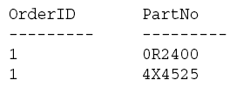
Insert into OrderDetails
Now we are ready
to insert into
Order Details
Verify the insert by running a select statement:
Two rows are returned:
INSERT INTO OrderDetails
VALUES
(1, ‘4X4525’, ‘This is a part’, 25.00, 2)
INSERT INTO OrderDetails
VALUES
(1, ‘0R2400’, ‘This is another part’, 50.00, 2)
SELECT OrderID, PartNo FROM OrderDetails

Slide 31
Cascade Effects
Even though we
issued a DELETE
against the Orders table
only, the DELETE also
CASCADED to our
matching records in the
OrderDetails table.
Records in both tables
were deleted. If we had
defined our table with a
CASCADE update and
updated a relevant record, then that too would have been propagated to the child table.
USE Accounting
-- First, let’s look at the rows in both tables
SELECT *
FROM Orders
SELECT *
FROM OrderDetails
-- Now, let’s delete the Order record
DELETE Orders
WHERE OrderID = 1
-- Finally, look at both sets of data again
-- and see the CASCADE effect
SELECT *
FROM Orders
SELECT *
FROM OrderDetails

Slide 32
What Makes Values in Foreign Keys Required vs. Optional
By the nature of a foreign key itself, you have two possible choices on what to fill into a column or columns that have a foreign key defined for them:
  Fill the column in with a value that matches the corresponding column in the referenced table.
  Do not fill in a value at all and leave the value NULL.

Slide 33
What Makes Values in Foreign Keys Required vs. Optional Cont.
You can make the foreign key completely required by simply defining the referencing column as NOT NULL.

Slide 34
How Foreign Keys Are Bi-Directional
By default, you cannot delete a record or update the referenced column in a referenced table if that record is referenced from the dependent table.

Slide 35
Unique Constraints
UNIQUE constraints are essentially the younger sibling of primary keys in that they require a unique value throughout the named column (or combination of columns) in the table.
You may hear UNIQUE constraints referred to as alternate keys.

Slide 36
Unique Constraints cont.
The major differences are that they are not considered to be the unique identifier of a record in that table (even though you could effectively use it that way) and that you can have more than one UNIQUE constraint (remember that you can only have one primary key per table).

Slide 37
Create Table with New Constraint
CREATE TABLE Shippers
(
ShipperID int IDENTITY NOT NULL
PRIMARY KEY,
ShipperName varchar(30) NOT NULL,
Address varchar(30) NOT NULL,
City varchar(25) NOT NULL,
State char(2) NOT NULL,
Zip varchar(10) NOT NULL,
PhoneNo varchar(14) NOT NULL
UNIQUE
)

Slide 38
Creating UNIQUE Constraints on Existing Tables
ALTER TABLE Employees
ADD CONSTRAINT AK_EmployeeSSN
UNIQUE (SSN)

Slide 39
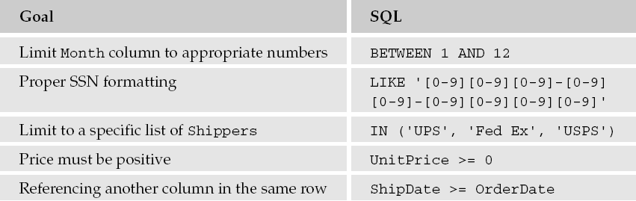
CHECK Constraints
The nice thing about CHECK constraints is that they are not restricted to a particular column.
The constraint is defined using the same rules that you would use in a WHERE clause.

Slide 40
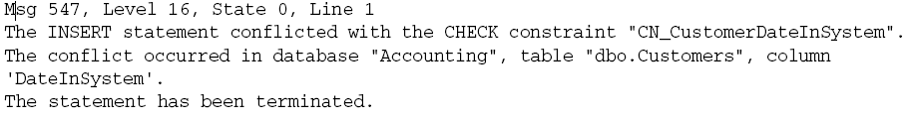
CHECK Constraints cont.
Add a modification to our Customers table to check for a valid date in our DateInSystem field.
Trying to insert a record that fails the CHECK constraint will produce an error:
ALTER TABLE Customers
ADD CONSTRAINT CN_CustomerDateInSystem
CHECK
(DateInSystem <= GETDATE ())

Slide 41
DEFAULT Constraints
A DEFAULT constraint defines what to do when a new row is inserted that doesn’t include data for the column on which you have defined the default constraint.
  Defaults are only used in INSERT statements—they are ignored for UPDATE and DELETE statements.
  If any value is supplied in the INSERT, then the default is not used.
  If no value is supplied, the default will always be used.

Slide 42
DEFAULT Constraints cont.
The syntax for a DEFAULT Constraint
CREATE TABLE Shippers
(
  ShipperID int IDENTITY NOT NULL PRIMARY KEY
  ShipperName varchar(30) NOT NULL,
  DateInSystem smalldatetime NOT NULL DEFAULT GETDATE()
  )

Slide 43
Disabling Constraints
There may be times when you need to disable a constraint:
  Data that’s already in your database when you create the constraint
  Data that you want to add after the constraint is already built
You cannot disable PRIMARY KEY or UNIQUE constraints.

Slide 44
Ignoring Bad Data When You Create the Constraint
Often data rules are established after the fact.
To add a constraint, but have it not apply to existing data, you make use of the WITH NOCHECK option when you perform the ALTER TABLE statement that adds your constraint.

Slide 45
Ignoring Bad Data cont.
For example, if we have a bad phone number (xxx-yyy-zzzz) in a record and we tried place a constraint on the phone number column, we would get an error:
To get around this, add a NOCHECK statement:
ALTER TABLE Customers
WITH NOCHECK
ADD CONSTRAINT
CN_CustomerDateInSystem
CHECK
(DateInSystem <= GETDATE ())

Slide 46
Rules and Defaults
The primary thing that sets rules and defaults apart from constraints is in their very nature; constraints are features of a table—they have no existence on their own—while rules and defaults are actual objects in and of themselves.
Whereas a constraint is defined in the table definition, rules and defaults are defined independently and are then “bound” to the table after the fact.

Slide 47

Rules
Rules are limited to working with just one column at a time.
A constraint defined as (QtyShipped <= QtyOrdered) would not work for a rule (it refers to more than one column), whereas LIKE ([0–9][0–9][0–9]) would (it applies only to whatever column the rule is bound to).

Slide 48
Activating Rule
Now we’ve got a rule, but it isn’t doing anything. If we tried to insert a record in our Employees table,we could still insert any value right now without any restrictions beyond datatype.
In order to activate the rule, we need to make use of a special stored procedure called sp_bindrule. We want to bind our SalaryRule to the Salary column of our Employees table. The syntax looks like this:
sp_bindrule ‘SalaryRule’, ‘Employees.Salary’

Slide 49
De-Activating Rule
To deactivate a rule, use sp_unbindrule:
EXEC sp_unbindrule ‘Employees.Salary’

Slide 50
Dropping Rules
If you want to completely eliminate a rule from your database, you use the same DROP syntax:
DROP RULE <rule name>

Slide 51
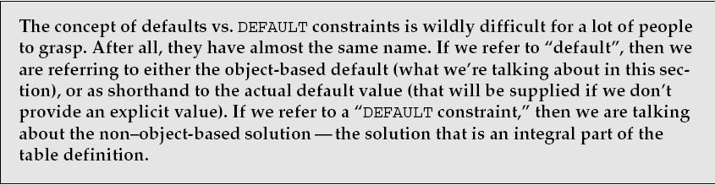
Defaults

Slide 52
Defaults contd
The syntax for a default is
Then it is bound using
CREATE DEFAULT SalaryDefault
AS 0
EXEC sp_bindefault ‘SalaryDefault’, ‘Employees.Salary’

Slide 53
Determining Which Tables are using Rules/Defaults
sp_depends provides a listing of all the objects that depend on the object you’ve requested information about.
EXEC sp_depends <object name>

Slide 54
Triggers
We will spend a whole week talking about triggers.
For now, understand that triggers have a very large number of things they can do data integrity–wise that a constraint or rule could never hope to do.
The downside is that they incur substantial additional overhead and are much slower in almost any circumstance.

Slide 55
What to use?
How do you figure out which is the right one to use?
Some of the constraints are fairly independent (PRIMARY and FOREIGN KEYs, UNIQUE constraints)—you are using either them or nothing.
The rest have some level of overlap with each other and it can be rather confusing when making a decision on what to use.

Slide 56
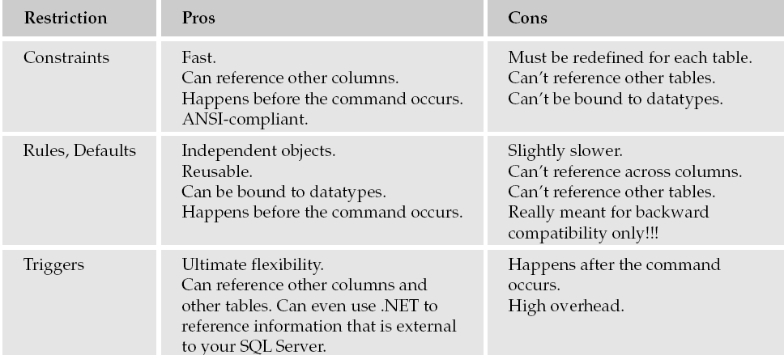
What to use cont.

